Slide 1
AI COLLUSION RESEARCH SPRINT 2026 · TRACK 1: MARKETS AND COLLUSION · QUESTION 1.2
Who Carries the Cartel?
LLM price collusion survives agent replacement through inherited price history
6 of 6
0.47–0.67
96%
runs: the same model with the old price history keeps the cartel
profit-index loss without the history, by overpricing
of rounds the OLMo-2 entrant repeats its last price
Supratik Bhowal · Apart Research
Notes:
Two AI agents that set prices for two competing firms often learn to keep prices high without being told to. We ask what happens when one of them is replaced. Short answer: the cartel survives if the new agent reads the old price history.

Slide 2
If a firm replaces its AI pricing agent, does collusion end?
AI agents that set prices can reach near-monopoly prices without talking to each other and without an instruction to collude.
Replacing one agent is a natural remedy, and it also happens every time a firm changes its software vendor or model version.
A prompted LLM agent has no memory outside its prompt. So the cartel must be carried by one of three things.
The model
1
the AI system itself (its weights)
The price history
2
the last 30 rounds of prices that the new agent reads
The notes
3
what the old agent wrote to itself each round
Notes:
The answer tells a regulator which item a remedy must change: the agent, the data it inherits, or its memory.

Slide 3
A simulated two-firm market with LLM pricing agents
Market: two firms sell similar products; buyers choose by price (logit Bertrand duopoly, Calvano et al. 2020).
Agents: each firm is an open LLM. Each round it sees the rules, its last 30 rounds and its notes, and answers with a price and new notes. The prompt never mentions collusion.
Models: Qwen2.5-7B incumbents; Mistral-7B and OLMo-2-7B as other-family entrants.
Two benchmarks define the scale
Competitive (Nash)
price 1.473
Monopoly
price 1.925
Profit index and price index: 0 = competitive level, 1 = monopoly level. A price above the monopoly price gives a price index above 1 but a lower profit index.
Notes:
A profit index near 1 means the two agents behave like a cartel. We report both indices because they disagree when prices overshoot the monopoly price.

Slide 4
Copy every cartel into eight exactly paired worlds
1
Phase 1
2
Keep cartels
3
Phase 2
4
Compare
Two Qwen2.5-7B agents play 100 rounds in 30–40 markets per run.
A market continues only if its profit index in rounds 50–99 is above 0.3.
Each kept market is copied into 8 conditions and plays 100 more rounds.
Same random seeds in every copy: differences come only from the replacement. Outcome: rounds 150–199.
Control
Placebo
Same + history
Same, no history
no replacement
incumbent told of a replacement; none happens
new Qwen agent, reads the last 30 rounds
new Qwen agent, starts blank
Same, notes only
Other + history
Other, no history
Best-response bot
new Qwen agent, gets the old notes only
Mistral-7B or OLMo-2-7B, reads the history
other family, starts blank
maximizes only today's profit (negative control)
Notes:
Six independent runs, hypotheses fixed in advance, 95% bootstrap intervals over markets. Runs without a stable cartel are reported too.

Slide 5
Result 1: the price history carries the cartel
6 of 6
independent runs: the same model with the history stays at the cartel level; without it, profits fall far.
No notice needed
In the run without a replacement notice the effect is the same (H1: 0.002). The old notes alone keep part of the cartel (H9: +0.342 over no history).
Notes:
Profit index 0 = competitive, 1 = monopoly. 'Same + history' differs from no replacement by between –0.025 and +0.213 across the six runs.

Slide 6
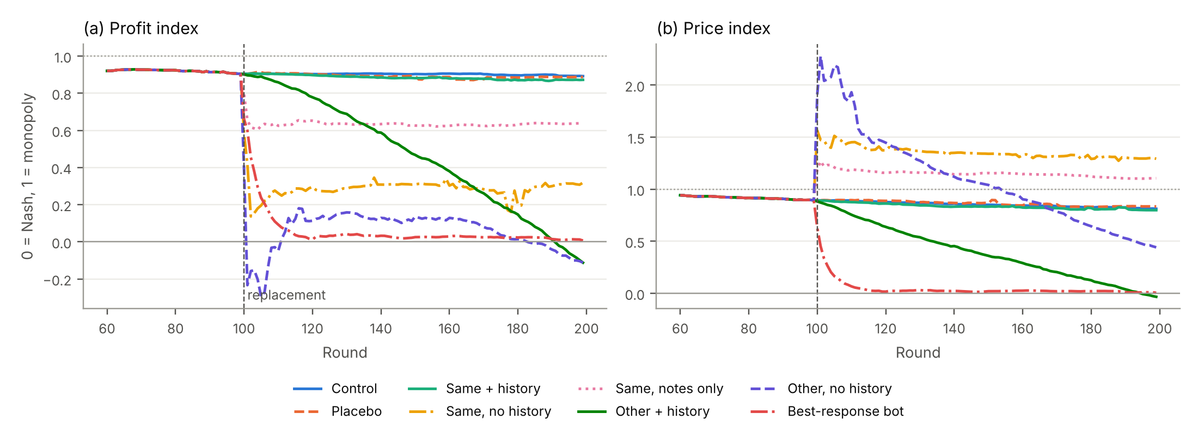
Result 2: without the history, prices overshoot
1.314
price index of the entrant without history in run 9 (above the monopoly level of 1)
A monitor that tracks only profits would call this the end of the cartel. Consumers still pay more than the monopoly price.
Run 9, mean over 29 markets per condition. Left: profit index. Right: price index. Dashed line: the replacement at round 100.
Price index of this entrant is above no replacement in 6 of 6 runs (interval above 0 in 5 of 6).
Notes:
The blank entrant has no anchor. It starts high and stays above the monopoly price, so both firms sell less. Only the best-response bot and the Mistral entrant reach competitive prices.

Slide 7
Result 3: the new model's pricing style decides the outcome
Mistral-7B entrant
OLMo-2-7B entrant
21.6–25.5%
96.3–96.8%
of rounds it repeats its last price
of rounds it repeats its last price
Breaks the inherited cartel in 4 of 4 runs: profit index 0.55–0.78 below no replacement. It explores, and prices drift down.
Keeps the inherited cartel in 2 of 2 runs. Typical note: “Maintain price at $1.93 as it consistently yields profit.”
Qwen2.5-7B agents without a replacement repeat their price in 87.7–90.8% of rounds. The price-hold rate can be measured before a model is deployed.
Notes:
'A different model' is not one treatment. A sticky model keeps the inherited prices by inertia; an exploring model drifts to competition.

Slide 8
Result 4: the surviving prices are anchored, not enforced
Force a cut
After calibration
1
In a copy of the market, one firm's price is forced 10% down for one round.
0 of 13
Measure the reply
audit cells show punishment in each of runs 6, 7 and 8
2
Does the rival cut more than a profit-maximizing best response would? That excess is the signature of punishment.
1 of 15
Calibrate
in run 9. The instructed trigger agent (positive control) is detected in runs 4 and 6–9.
3
A myopic agent that cannot punish also follows cuts. Count punishment only above this myopic baseline.
Without calibration, 0–3 cells per run would look like punishment.
Notes:
The inherited high prices persist because the agents anchor on what they see, not because they threaten a price war.

Slide 9
What this means: govern the transcript, not only the agent
Competition authorities
Market monitors
Replacing a colluding pricing system is not a remedy if the shared price history moves with the seat. Remove or redact the history and the notes.
A fall in profits is not proof of competition. Compare prices with both the competitive and the monopoly benchmark.
Auditors
AI safety
Calibrate enforcement tests against agents that cannot punish, or ordinary price following looks like a cartel.
Coordination stored in shared memory, logs or transcripts can outlive the agents that created it.
Notes:
The unit of analysis moves from the agent to the agent and its context.

Slide 10
Limits, next steps and materials
Limits
Next steps
One simulated market, one prompt, 7–14B open models.
Only Qwen2.5-7B incumbents kept a stable cartel; two entrant families gave opposite results.
The audit tests a one-round reply to a one-round cut.
Runs 4–5 ran before the sprint start (disclosed).
More model families; test the price-hold rate as a predictor.
Vary the inherited history from 0 to 30 rounds.
Multi-round audits; remedies that redact shared memory.
Code:
github.com/SupratikB23/LLM-Cartel-Succession
Notes:
All numbers come from stored run data through the analysis code in the repository. The report lists every run, null results and failures.

